Slide 1






⥫
Forecasting Air Quality with LSTM
A Deep Learning Approach to Time Series Analysis
Presented By : Mohammed Houbid

Slide 2

Understanding Air Quality Forecasting
Why Predict Air Quality?
- Rising pollution levels and their impact on health.
- Importance of accurate forecasting for policy and personal planning.
What is an LSTM ?
- A specialized type of neural network for time-dependent data.

Slide 3
Understanding LSTMs and Time Series Analysis
Time Series Analysis: Focuses on trends, seasonality, and patterns in sequential data.
LSTM Overview: An advanced neural network for time-dependent data, ideal for forecasting.
Key Advantage: Retains long-term dependencies while filtering noise effectively.

Slide 4
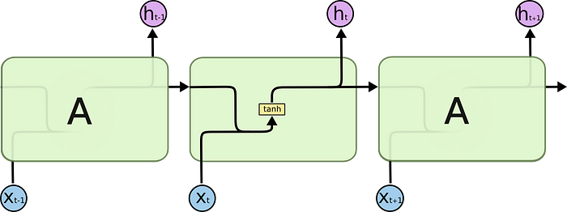
The Basics of RNN
Basic idea: RNNs are used to process sequences of data like text, time series, and -omics data, which excel in tasks such as language modeling, speech recognition, and gene expression prediction.
Structure: They have a memory to persist previous information, which allows them to process sequences of inputs by using their internal state (memory) to store information about earlier inputs (Figure 1).
Problem: They often have difficulty maintaining long-term memory of sequence data dependencies. For example, if there exists a large gap between relevant information and the point where it is needed, then RNNs can’t learn effectively. The issue is called the “vanishing gradient problem.”

Slide 5
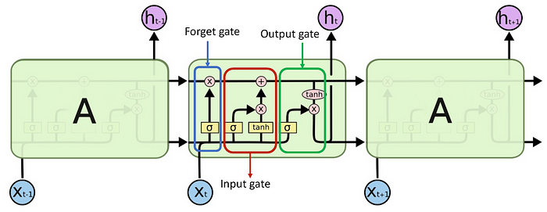
Advancements with LSTM
Enhanced RNN: LSTMs are created to fix the vanishing gradient problem.
Structure: They have added components called gates, such as input, output, and forget gates, into their structure, which is more complex than RNNs.
▪ Input gate: It decides what new information to store in the memory. ▪ Output gate: It decides what to output based on input and the memory of the LSTM. ▪ Forget gate: It decides what information to throw away or keep.
Advantage: These gates allow LSTMs to retain or remove information over time, which makes them excel in analyzing time series data and sequences of inputs.

Slide 6

LSTM Advantages for Forecasting
1- Retains Long-Term Dependencies
Uses memory gates to remember significant past data for better predictions.
2- Handles Noisy and Irregular Data
Effectively filters out outliers and irrelevant fluctuations.
3- Ideal for Environmental Data Trends
Captures complex patterns and seasonality in time series data.

Slide 7
Example: Predicting Temperature Trends
To begin with, we want to forecast the temperature for the next day based on past data. Here’s how an LSTM cell works on this task:
Day 1: The temperature is 70°F, which becomes part of the LSTM’s initial memory.
Day 2: It’s a hot summer day and the temperature rises to 90°F. The LSTM’s input gate adds this new data to its memory, which significantly impacts the prediction because it’s a quick change.
Day 3: The temperature drops to 75°F. The forget gate probably decides that the spike to 90°F was an outlier and not entirely relevant for long-term prediction, so it “forgets” part of this spike. The input gate adds the new temperature of 75°F to adjust the memory.
For the next day’s temperature prediction, the LSTM uses updated memory of past days and downplays outliers for accuracy.

Slide 8


Hands-On Guide with Air Quality Dataset
1. Dataset Overview -
Source: UCI Machine Learning Repository.
- Features
Date: When the data was recorded.
Time: Time of day for the data.
CO(GT): Carbon Monoxide level.
PT08.S1(CO): Sensor response for CO.
NMHC(GT): Non-methane hydrocarbons level.
C6H6(GT): Benzene level.
PT08.S2(NMHC): Sensor response for NMHC.
NOx(GT): Nitrogen Oxides level.
PT08.S3(NOx): Sensor response for NOx.
NO2(GT): Nitrogen Dioxide level.
PT08.S4(NO2): Sensor response for NO2.
PT08.S5(O3): Sensor response for Ozone.
T: Temperature.
RH: Relative Humidity.
AH: Absolute Humidity.

Slide 9
Hands-On Guide with Air Quality Dataset
2. Tasks -
- Load and preprocess data.
- Visualize time series for trends.
- Apply LSTM for forecasting NO2 concentrations.
Load the dataset and perform initial exploratory data analysis focused on time series aspects.
Handle missing values and preprocess the data for time series analysis.
Visualize the time series data to understand trends, seasonality, and noise.
Use a time series forecasting method, such as LSTM to predict future pollution levels.
Evaluate the model’s forecasting accuracy.

Slide 10
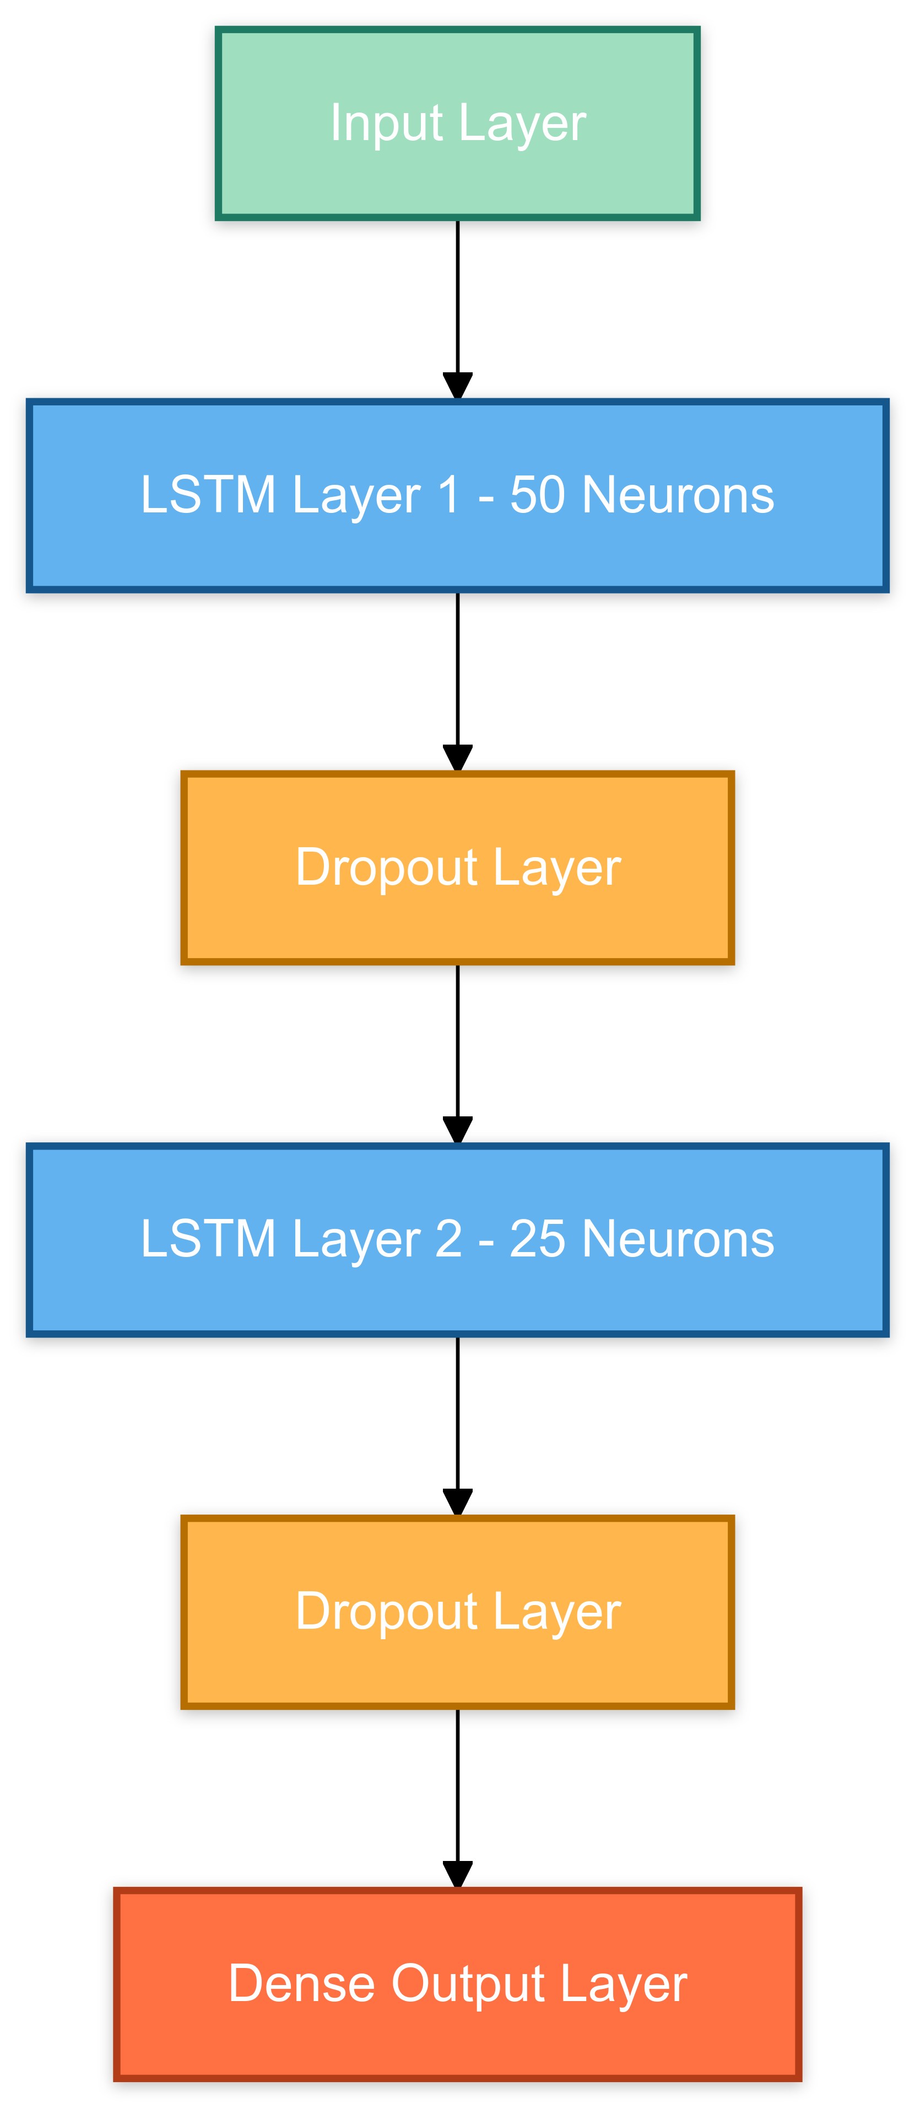
Model Architecture and Evaluation
Let’s simplify the use of LSTMs with Dropout layers for processing sequence data:
Sequential Model: Begins a model where layers are added sequentially.
First LSTM Layer: 50 neurons, processes input data in sequences, outputs a sequence. It also uses small L1 and L2 regularization on its weights to prevent overfitting.
First Dropout Layer: Drops 30% of inputs randomly to prevent overfitting.
Second LSTM Layer: 25 neurons, only outputs final result from the sequence, and applies small L1 and L2 regularization to its weights to reduce overfitting.
Second Dropout Layer: Another 30% dropout for further regularization.
Dense Layer: The final layer with 1 neuron, predicts a single output value.

Slide 11

Model Evaluation Metrics
The meaning of the following evaluation metrics:
RMSE (Root Mean Squared Error): It is a standard way to measure the error of a model in predicting quantitative data.
MAE (Mean Absolute Error): It measures the average magnitude of the errors in a set of predictions, without considering their direction.
The comparing training and test metrics for model evaluation:
Training RMSE and MAE: Indicate how well the model fits the training data.
Test RMSE and MAE: Show how well the model is expected to perform on unseen data.

Slide 12
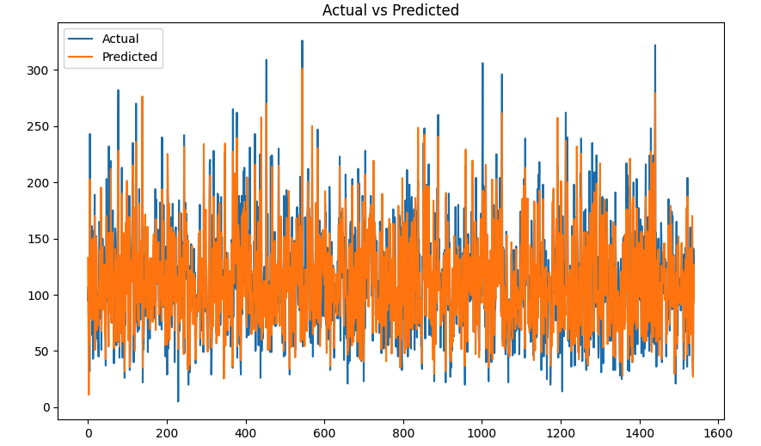
Model Evaluation Metrics
Test RMSE: 19.97, Test MAE: 15.19 , Test R2: 0.83

Slide 13

Real-World Applications
Advanced LSTM techniques are being applied in various real-world applications such as
urban planning, public health monitoring, and environmental policy-making. Accurate
air quality forecasts can help mitigate health risks and improve community well-
being through informed decision-making.

Slide 14
Conclusion and Future Directions
In conclusion, advanced LSTM techniques offer signiﬁcant potential for improving air quality forecasting. Future research may focus on integrating LSTM with other machine learning models and exploring the impact of emerging data sources for even greater predictive accuracy.

Slide 15








Thanks!
Any Questions ?

